Slide 1

SCHOOL FEE PAYMENT SYSTEM
Prepared By: RUKESH BASUKALA

Slide 2
Introduction
School fee payment system includes each and every student admitted.
Makes easy for the management of schools.
Consists of adding of new students, listing students record, modifying the students detail and many more…

Slide 3
Objective
To keep track of each and every detail of student in the school.
To make fee paying easier for the payer and receiver.
To save time for the user to display and search for details of every student.
Well protection for details of the student by password entry system.
Simplifies the task and reduce the paper work.

Slide 4
Advantage
The system is convenient and flexible to use.
It saves schools time, efforts, money and resources.
Password protected.

Slide 5
Limitation
The user has to manually keep updating the information by entering the details in the system.
Chance of mistake.
Can’t go back in menu without entering data.
The user can not delete records.

Slide 6
Future Implementation
Making the Software as a online application such that the program can be used anywhere and anytime.
Adding new payment medium like online transfer
We can make software automated.
We can add delete option to delete unnecessary records.
We can also make the project more attractive.
The number of people handling the software can be made unlimited in future.

Slide 7
Hardware & Software
Requirement
Hardware Requirements
Processor : P-3 or Higher
Ram : 256 MB or more
Hard Disk : 1 GB or more
Monitor : color monitor
Software Requirements
Operating System : MS Windows XP, 7, 8, or 10
Compiler : C language

Slide 8
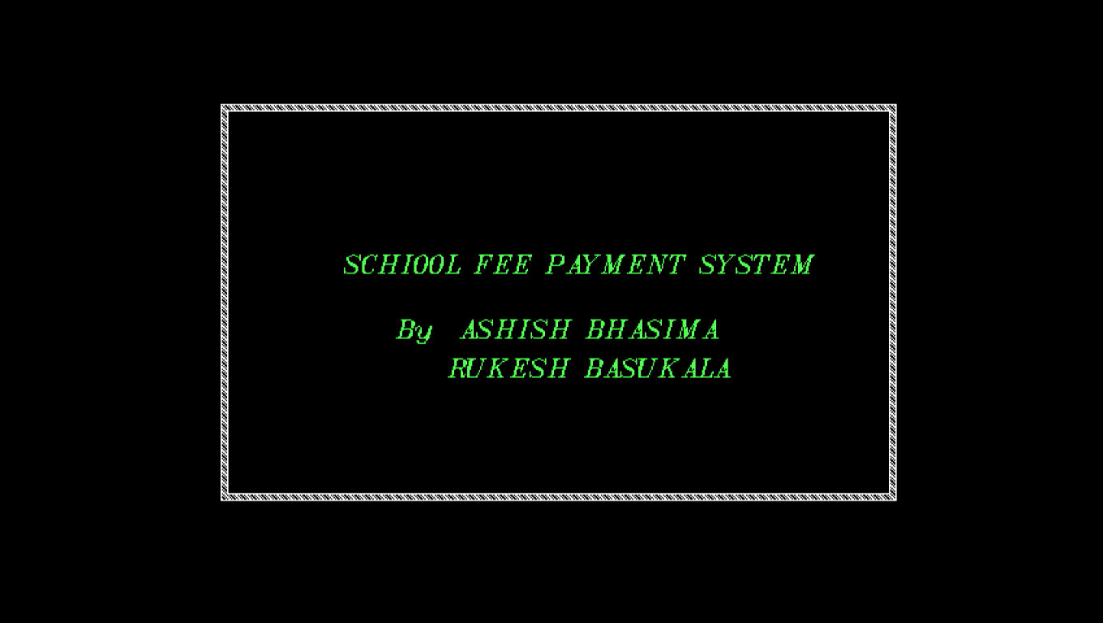
Output
First Screen

Slide 9
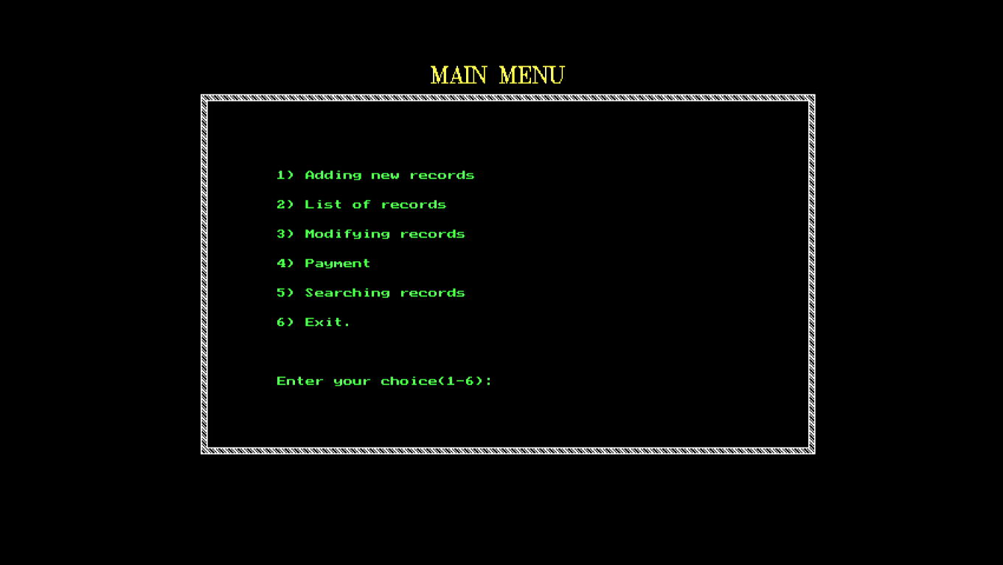
Main menu

Slide 10
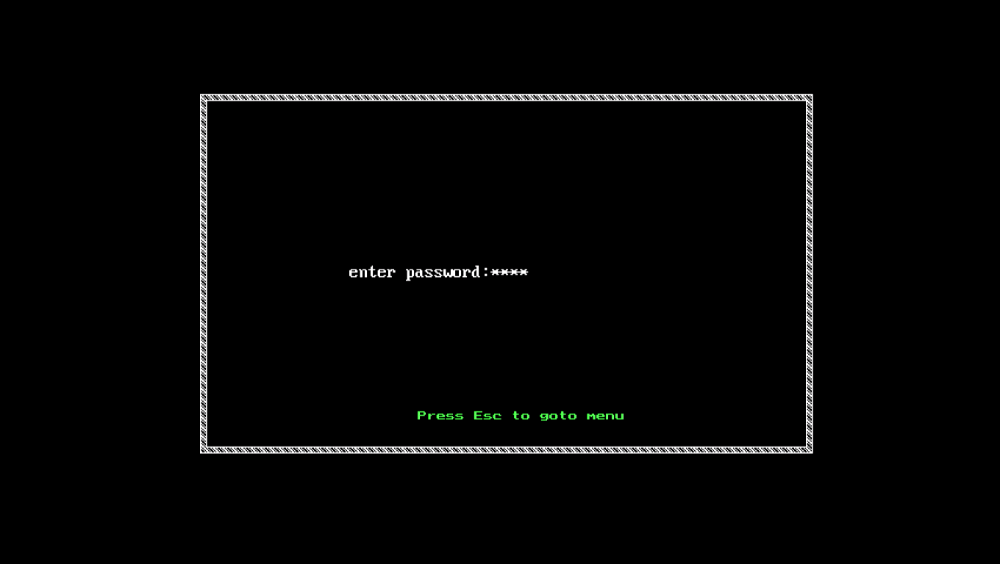
Password Screen

Slide 11
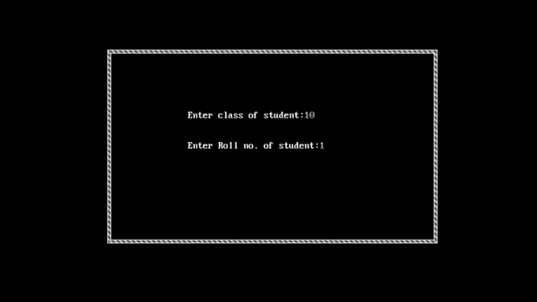
Student Information

Slide 12
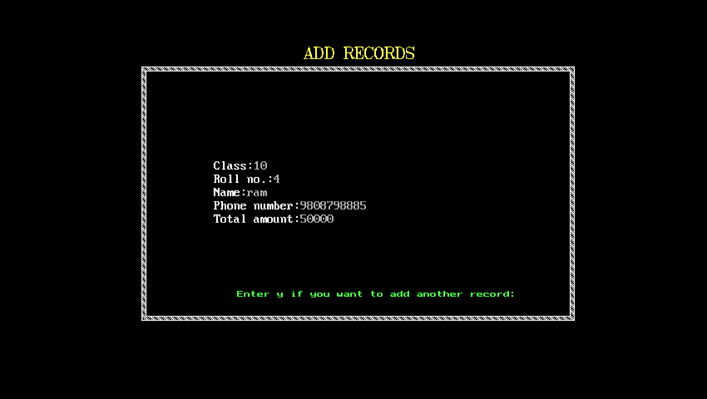
Add Records

Slide 13
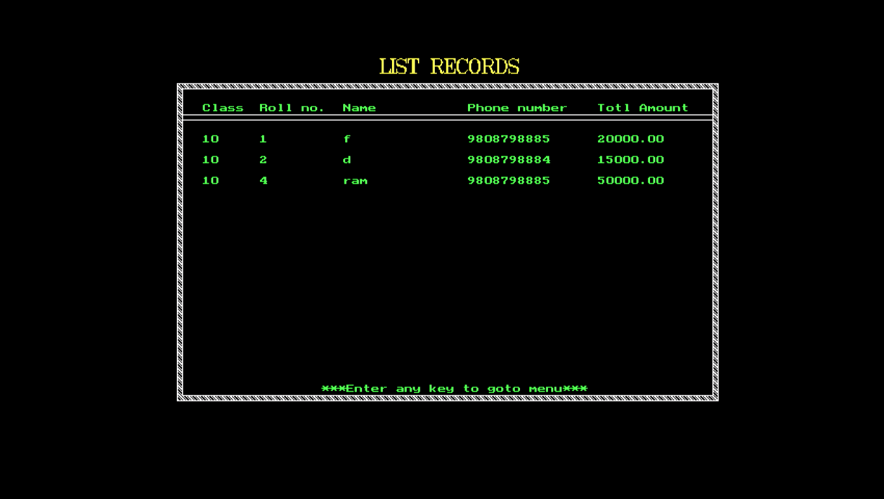
List Records

Slide 14
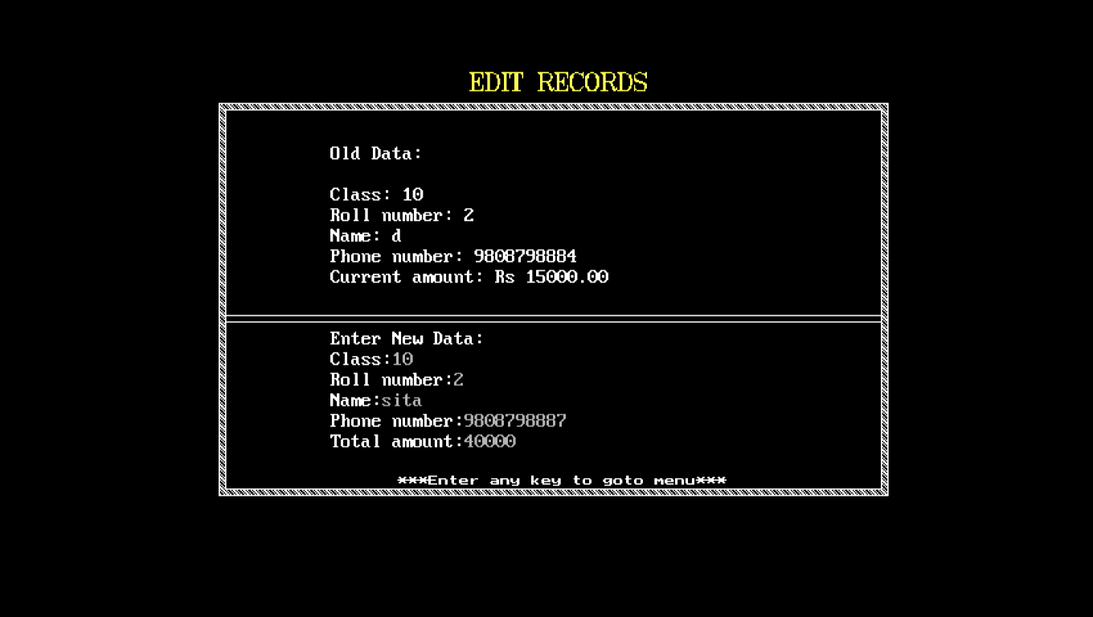
Edit Records

Slide 15
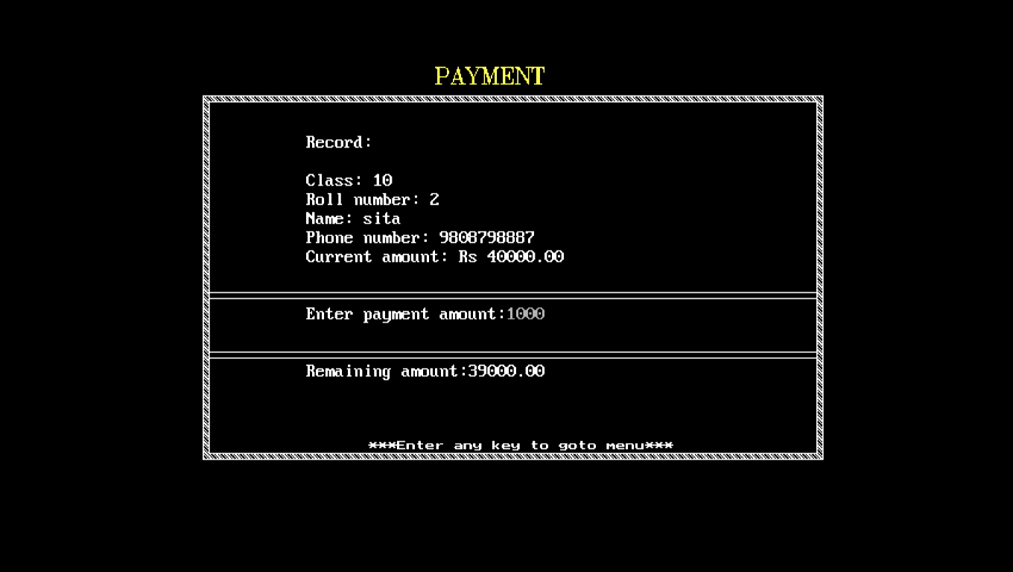
Payment

Slide 16
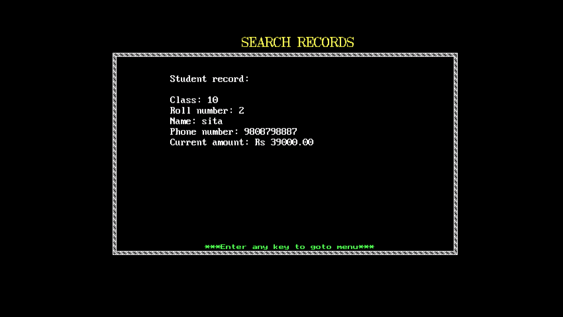
Search Records

Slide 17
ANY QUESTION
?
?
?

Slide 18
T
H
A
N
K
YOU

